Slide 1
Class and Object in Java
Class in Java
A class is a blueprint or template for creating objects. It defines the properties (fields/variables) and behaviors (methods/functions) of objects. It does not occupy memory until an object is created.
Object in Java
An object is an instance of a class. It holds the actual values of the properties and can invoke methods defined in the class.

Slide 2
Key Differences Between Class and Object
Feature | Class | Object
Definition | A blueprint/template for creating objects | An instance of a class
Memory | Does not consume memory until an object is created | Occupies memory when created
In simple terms: A class is like a "design plan," and an instance is a "real product" created
from that plan.

Slide 3
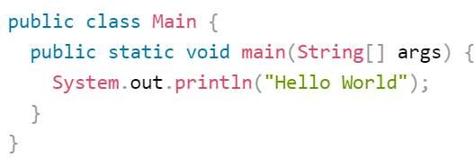
SYNTAX

Slide 4
public class Main {
public: This keyword specifies the visibility of the class. public means that the class can be accessed from other classes.
class: This keyword is used to declare a class in Java.
Main: This is the name of the class. In Java, the name of the class must match the filename (without the .java extension) where it's defined.

Slide 5
public static void main(String[] args)
public: This keyword specifies the visibility of the method. public means that the method can be accessed from other classes.
static: This keyword indicates that the method belongs to the class itself, rather than to instances of the class.
void: This keyword indicates that the method doesn't return any value.
main: This is the name of the method. In Java, the main method is the entry point for the program.
(String[] args): This is the parameter list for the main method. It accepts an array of strings as arguments. args is a conventional name for this parameter, though you could choose any valid Java identifier.
public static void main(String[] args).

Slide 6
Printing output
In Java, the System.out.println() method is commonly used to print output to the console.
Example 1:

Slide 7
System.out.println("Hello World");
System.out: System is a class in the java.lang package. out is a static member of the System
class that represents the standard output stream.
println: This is a method of the PrintStream class (associated with standard output) that prints a string to the console followed by a newline character.
"Hello World": This is the string that will be printed to the console. It's enclosed in double quotes to denote a string literal.

Slide 8
Data Types
Data types are used to define the type of data that a variable can hold.
Data types are divided into two groups:
Primitive data types -
includes byte, short, int, long, float, double, boolean and char
Non-primitive data types - such as String, Arrays and Classes (you will learn more about these in a later chapter)

Slide 9
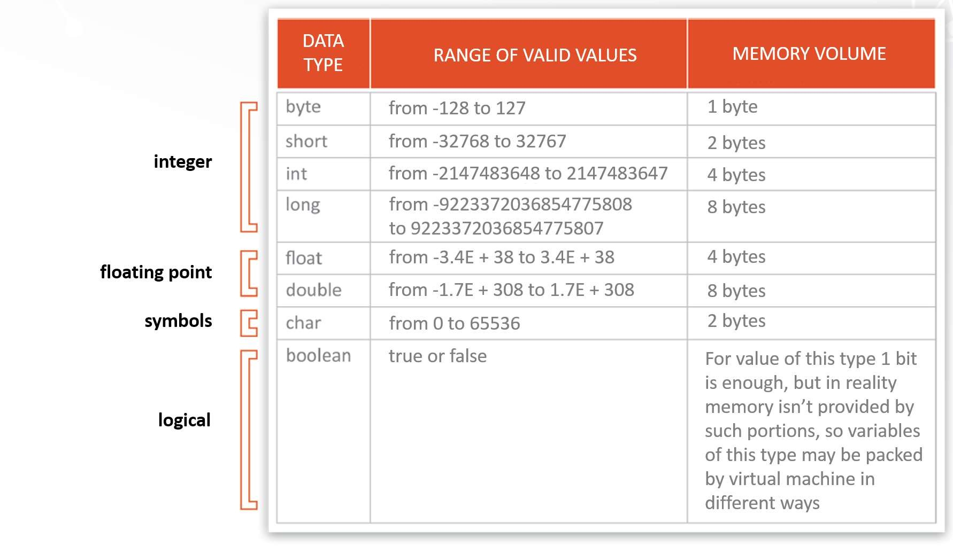
Data type
•
jdfdf

Slide 10
Variable
A variable is a container which holds the value while the Java program
Variable is a name of memory location.
A variable is the name of a reserved area allocated in memory. In other words, it is a name of the memory location. It is a combination of "vary + able" which
means its value can be changed.
A variable should assigned with a data type.

Slide 11


Example
int 123variable;
int myVariable;
double String
_value;
$name;
double
my-variable;
int my value int my@value int class; int
= 20;
= 30;
int myVar123;
int numberOfStudents;
String
userName;
thisIsAVeryLongVariableNameThat;

Slide 12
Rules for creating variable
In Java , before variable you should declare a data type
All variables name must begin with alphabet or underscore
Can only contain alpha-numeric characters and underscores
Case-sensitive (name, Name and NAME are three different variables)
The reserved words(keywords) cannot be used naming the variable
The initial can be of $ or _ no other special characters.
The initial cannot be numbers but can be in-between.
No space or allowed in between the variable
It is better to give meaning full word when you create application
We can not include more then 255 character into it

Slide 13
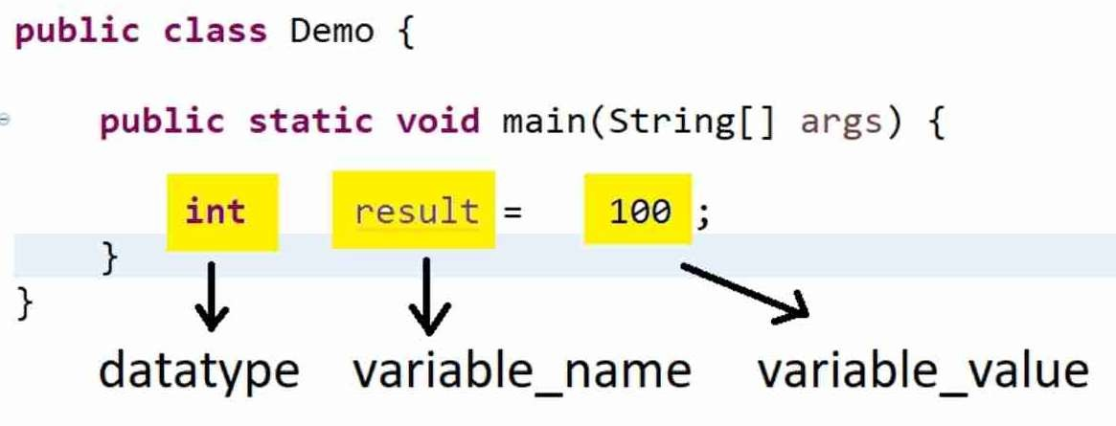

Slide 14
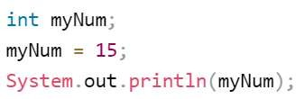


Declaring (Creating) Variables
Syntax:-
type variableName = value;

Slide 15
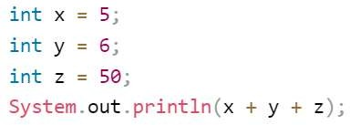



Slide 16
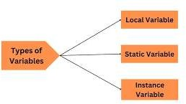
Three types of variable
There are three types of variables in Java
Local Variable
Instance Variable
Static Variable

Slide 17
Local Variable
A variable declared inside the body of the method is called local variable.
A local variable cannot be defined with "static" keyword.
public class Loc {
public static void main(String[] args) { int loc= 10;
System.out.println(“The value of localvar: " + loc);
}
}

Slide 18
Instance Variable
An instance variable is associated with instances (objects) of a class.
Each instance of the class has its own copy of the instance variables, which are separate from those of other instances.
Instance variables are declared within a class but outside any method,
constructor, or block.
Syntax to create Object:
ClassName objectName = new ClassName();

Slide 19

public class InstanceVar {
int insvar= 20;
public static void main(String[] args) {
InstanceVar obj=new InstanceVar();
System.out.println(obj.insvar);
}
}
Object creation

Slide 20
Static Variable
In Java, a static variable (also known as a class variable) is a variable that belongs to the class itself, rather than to instances (objects) of the class.
This means there is only one copy of the static variable shared among all instances of the class.
public class StaticVar {
static int insvar= 20;
public static void main(String[] args) { System.out.println(insvar);
}
}

Slide 21

Constant variable
In Java, a constant variable refers to a variable whose value cannot be changed once it has been assigned.
To create constant variables, you use the final keyword.
Constants are typically used for values that should not be modified during the execution of a program.
By convention, the names of variables defined as final are UPPER CASE.
public class Circle {
final double PI = 3.14159;
}

